Slide 1
Kinetic Molecular Theory, Density, and Thermal Expansion
Exploring Sea Level Rise

Slide 2
Learning Targets:
Describe how heat is transferred between the system and the surroundings.
Define Kinetic Molecular Theory.
Describe how a change in temperature affects the molecules/atoms of an object.
Explain the relationship between number of particles, volume, and temperature.
Define thermal expansion.
Explain how phase change and thermal expansion are related to rising sea levels caused by human caused climate change.

Slide 3
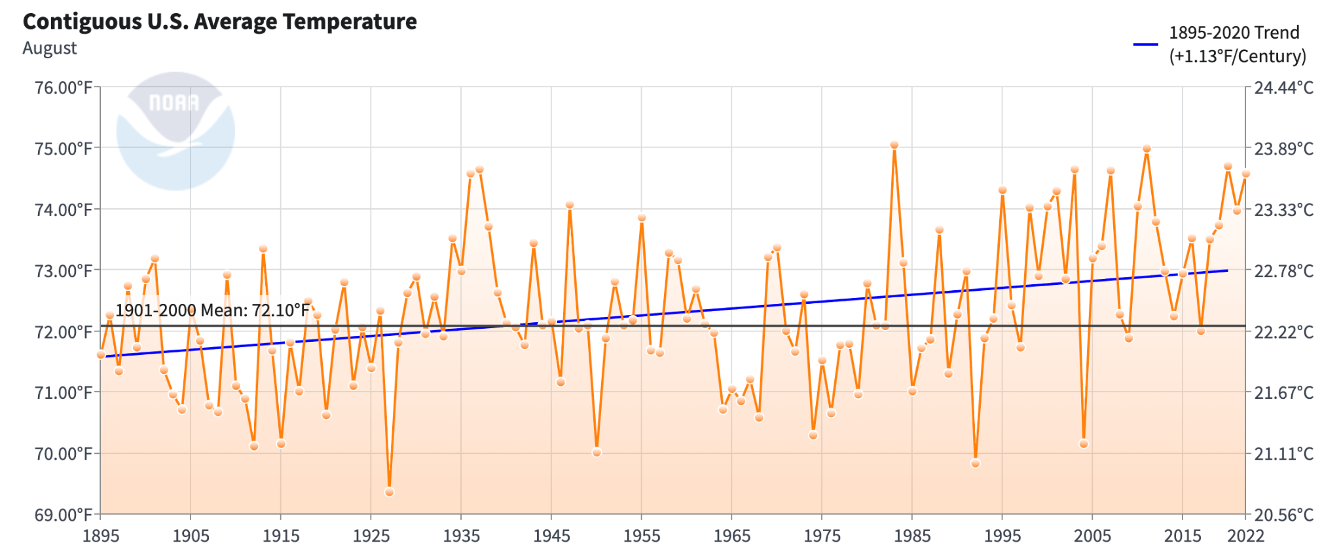
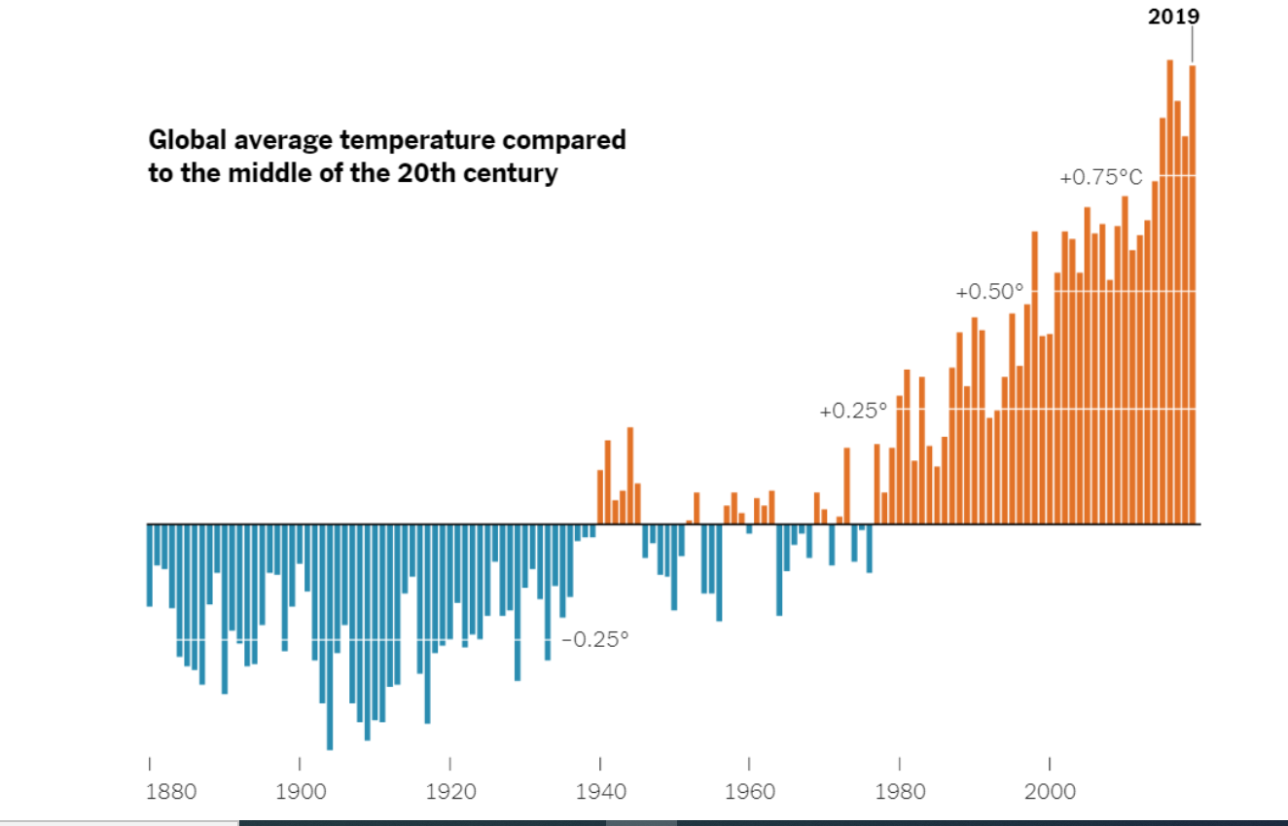
Warm-up: Global Temperatures-
What do you notice? What do you wonder? Did you observe a similar trend in the data visualizations from last class?

Slide 4
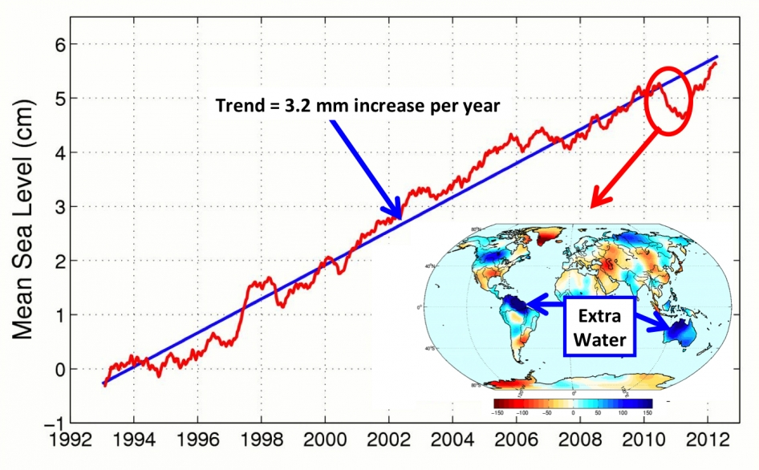
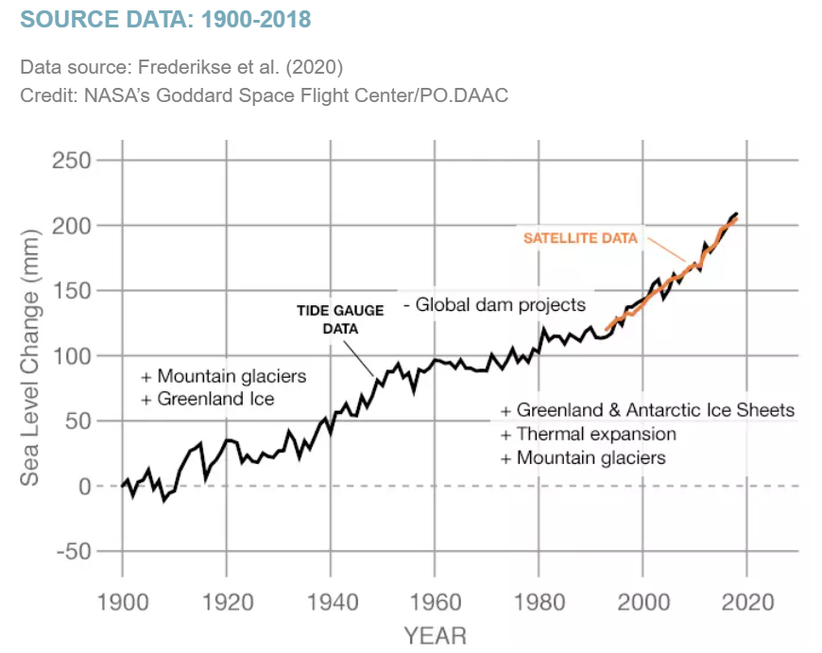
Warm-up: Sea Level-
What do you notice? What do you wonder? Do you think there is a relationship between global temperatures and sea level? Did we observe a similar to the relationship last class?

Slide 5
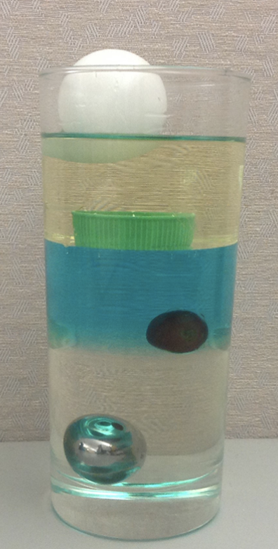
Review: Density-
Discuss the following with your table:
What is density?
Which is the most dense: solid, liquid, or a gas?
Look at the density column to the right.
Which is most dense- the ping pong ball floating on the top or the steel bearing at the bottom?
Do the liquids have the same density?
Notes:
Give students a minute to consider the question
Have them discuss with a shoulder partner
Report out on the next slide…. or print out table tents with the prompts and so students have them in their hands while they look at this slide

Slide 6
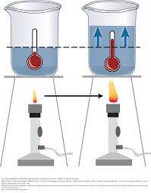
Review: Thermal Expansion-
Thermal Expansions Demos
Using the diagram to the right, discuss the following with your table:
What happened to the volume of water in the beaker? The mass?
What happens to the density of water when it’s heated? Using the density table below, which densities would match the beakers?
Describe what is happening to the water particles in the beaker.
Water Temp (˚C) | Density (g/mL)
10 | 0.999700
20 | 0.998203
30 | 0.995646
Notes:
Let’s say that for every 3 cm the water climbs in the tubing that is equal to 1 mL. Ex: If the water level rose 15 mL then that is an additional 5 mL of space that the water did not take up before. Since this is a 1000 mL flask, then the volume is now 1005 mL. Why does the water expand to take up more space? The particles/molecules in the water gained energy from the heat and light provided by the lamp. This caused the water molecules to gain KE so they are moving more which means they will now occupy more space.
Where does mass come from? Ex: you are made of cells, which are made of molecules which are made of elements. Each element has protons & neutrons that give it mass. The mass of the flask can only change if we add water molecules or take them away. Did this happen? No, the number of particles/molecules stayed the same so the mass is the same.
How has the density changed? How do we find density? What is it the ratio between? When we calculated the density of H2O in our lab at room temp, we said that it was 1 g/mL. That means if we set 1 g/mL = M/1000mL then we had 1000 g. If the mass stays the same but we now have more vol then 1000 g/1005 mL = 0.995 g/mL so the density has gone down because the mass stayed the same while the volume increased.
What’s in the bubbles or how does the clear condensation form at the top of the flask? Remember that the temp of the sample is the AVG KE, there will always be some particles/molecules with more KE that can break away from the attraction and move far enough apart to become a gas. When they rise and surface (for bubbles) the molecules hit the top of the flask and bottom of the stopper which are cooler and they loose KE and fall back down the hill into a liquid again. This gas is H2O!!! Remember the PhET when you watched the water turn into a gas? The molecules were still made up of 1 red and 2 white (1 O and 1 Hs). We never saw two red and two white split off and form their own gas. If it were O2 & H2 this would be a chemical change that takes much more energy than what is provided by the lamp. It can’t be air because how does air get to the bottom of a pot of water where the “vapor” bubbles are forming?

Slide 7
Introduction: Role of Oceans in Regulating Rising Global Temperatures-
Oceans Give, Oceans Take
Absorb heat energy trapped from increasing greenhouse gases.
Water has a high heat capacity
Thermohaline cycle- uses convection and density differences to transfer heat in the oceans
Absorb Carbon dioxide (CO₂)
Buffer system- regulates the pH of a system
Since the ocean is absorbing high levels of CO₂ the buffer system is not as effective and makes the ocean increasingly acidic

Slide 8
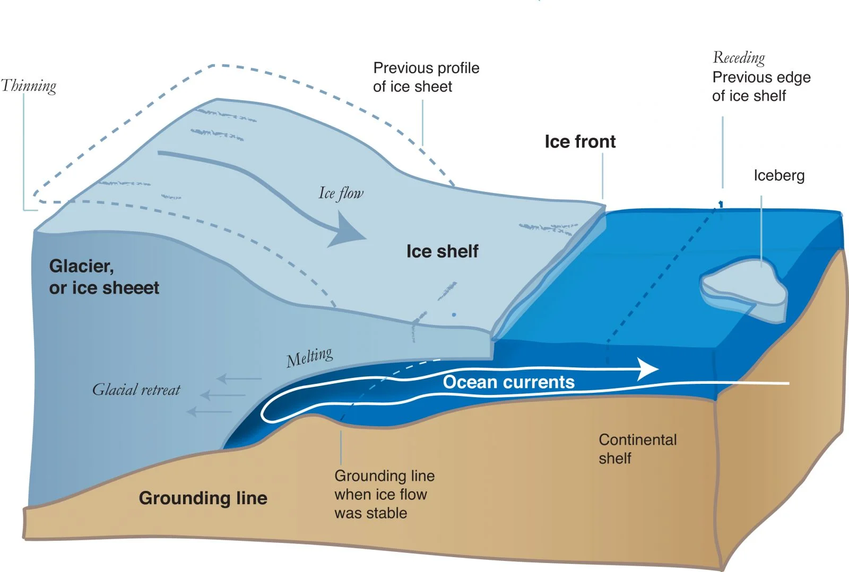
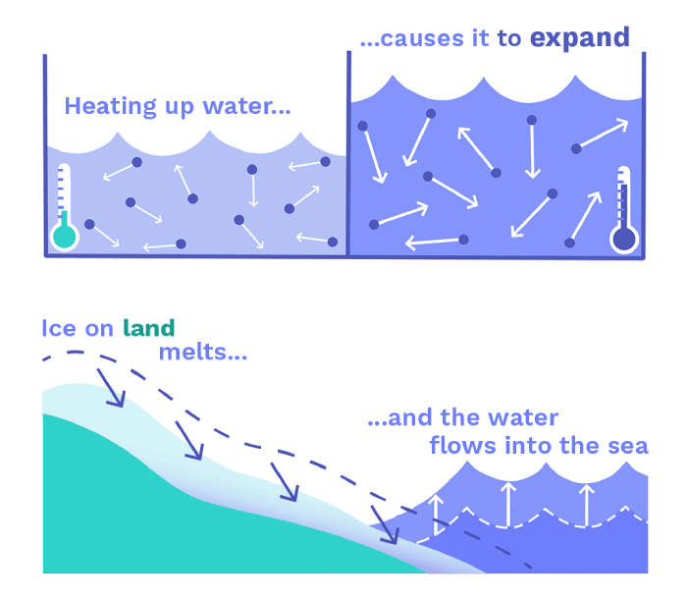
Introduction: Major Causes of Sea Level Rise-
Melting of Ice Sheets & Glaciers
Addition of freshwater
Ice from glaciers melt and run into the ocean, rising sea levels
Melting Ice Sheets (land ice)- contributes to an increase in sea level
Melting sea ice does not change sea levels (like ice melting in a glass)
Thermal Expansion of Water
Expansion of water as energy (heat) is absorbed by the water molecules in the oceans
Source: Scientific American
https://www.scientificamerican.com/article/antarctic-quest-seeks-to-predict-the-fate-of-a-linchpin-glacier/
Source: ClimateScience
https://climatescience.org/advanced-climate-sealevel-rise

Slide 9
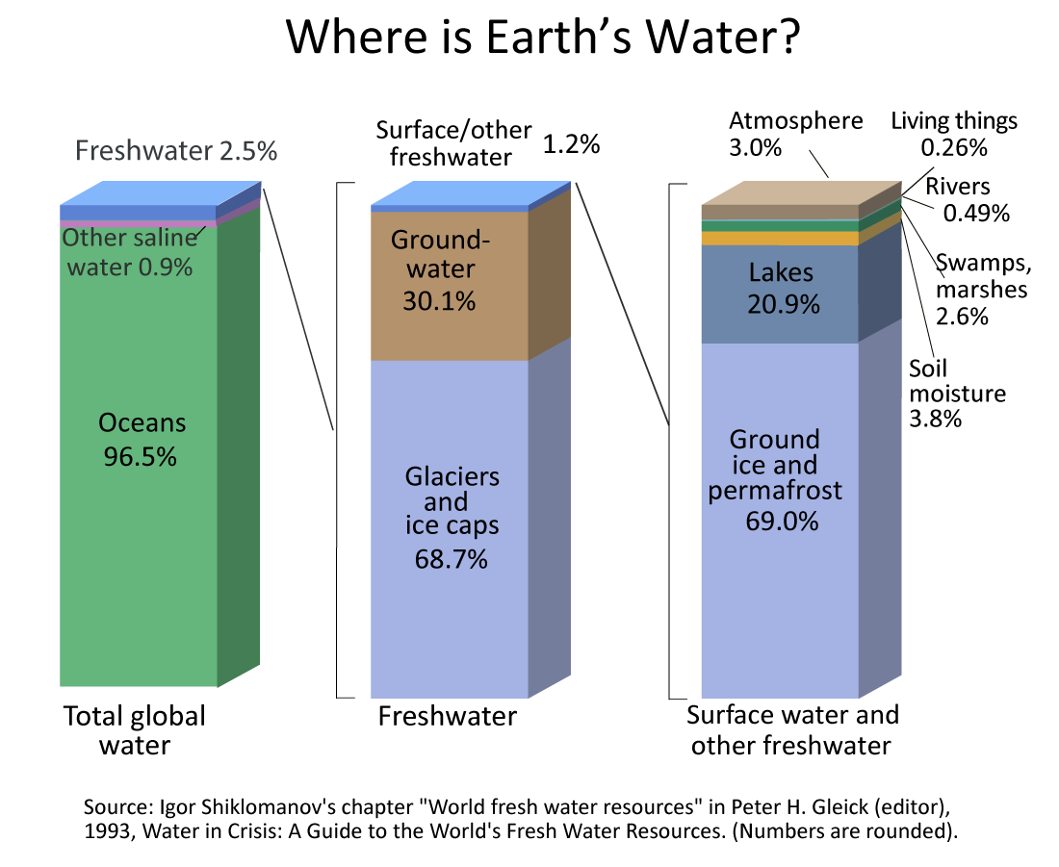
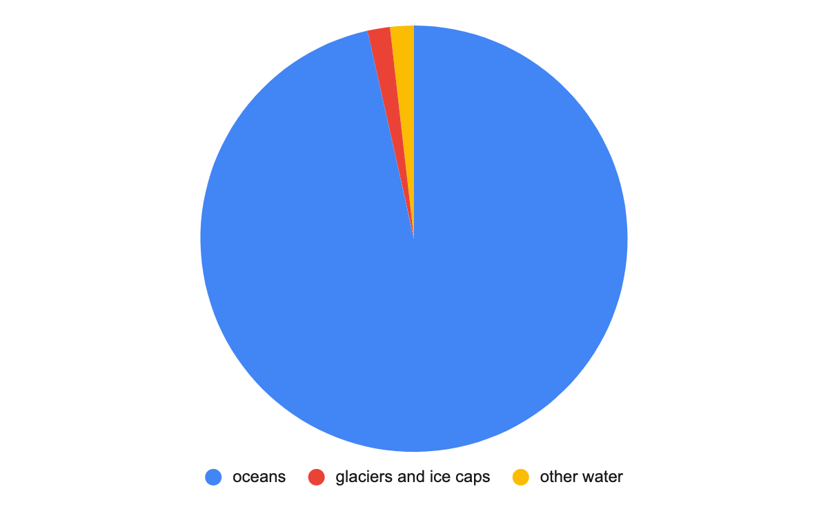
Introduction: Where is Earth’s Water-
96.5 % of the water on the earth is in the oceans
1.7% of the water on the earth is in the form of ice.
Notes:
Before writing your final CER consider that the majority of water on Earth is in the ocean. Only 1.7% of Earth’s water is locked in glaciers/ice caps. Thermal expansion is the real reason we are worried about global temps going up and sea levels rising. If the global temp goes up, so will water temps and if every L of H2O on the planet increases by a few mL then sea level will rise and soon cities like Seaside and whole islands will be underwater.
Thermal expansion happens to ALL substances. The metal/concrete/wood in the bridge will expand when the sun shines on them, again increasing their KE and moving them from the valley up the hill a bit. If we don’t build spots for this expansion to take place, the bridge would buckle and break.

Slide 10
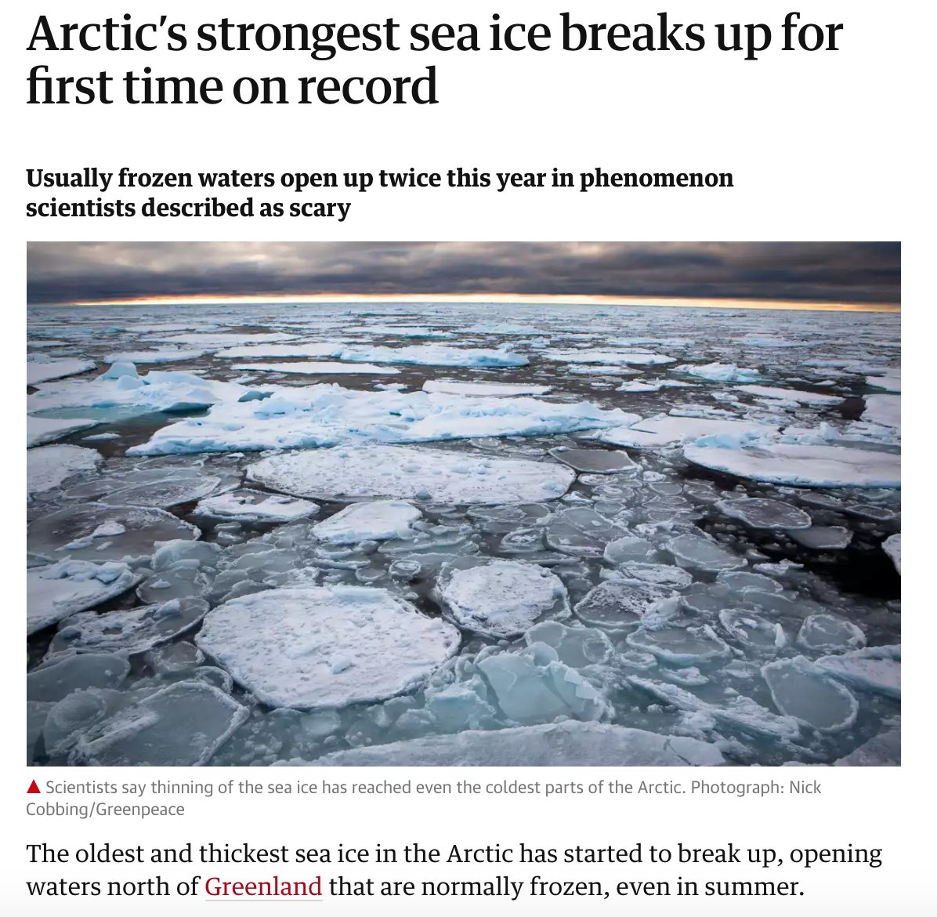
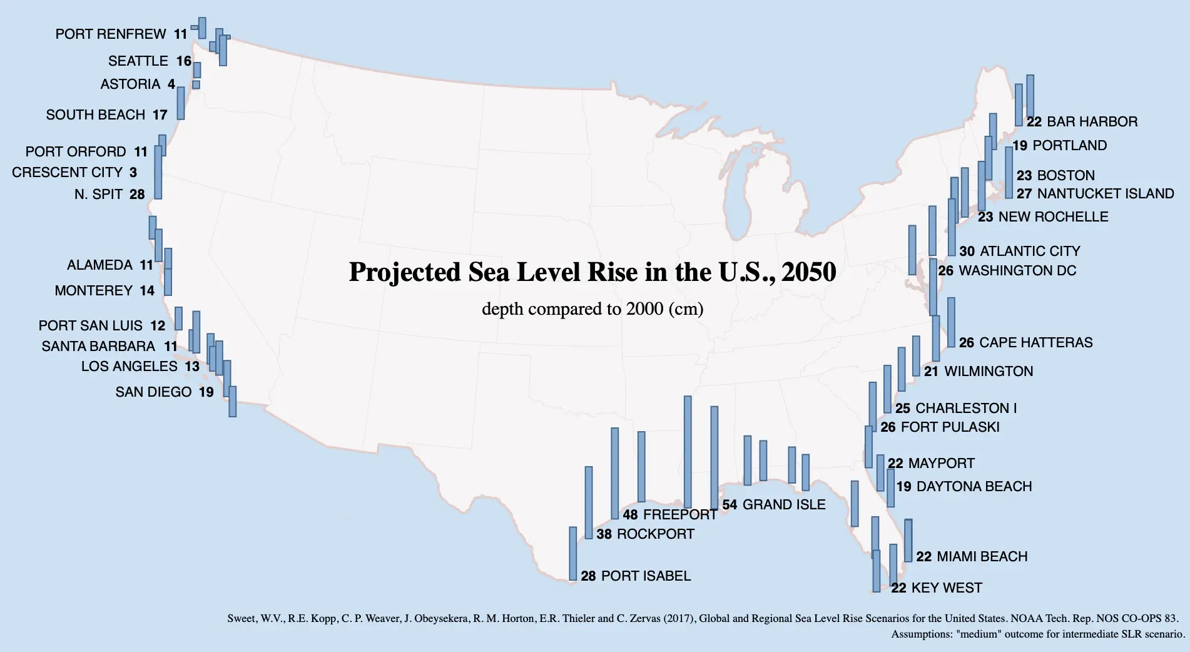
Introduction: Melting Sea Ice & Ice Sheets-
In 2018 the Arctic’s oldest and thickest sea ice broke up for the first time
In 2019, 12.5 tons of ice melted off the coast of Greenland.
Sea Levels have risen 4 inches since 1993
What happens when ice sheets melts? Where does the water go?
Is there a difference between sea ice and ice sheets (land)?
Can melting glaciers and ice sheets account for all sea level rise?
Notes:
Give students a minute to consider the question
Have them discuss with a shoulder partner
Report out on the next slide…. or print out table tents with the prompts and so students have them in their hands while they look at this slide

Slide 11
Phenomena: Sea Level Rise-
Sinking Cities
Think about the following questions, as you watch the video:
What are some possible short or long term effects of rising sea levels?
Are all coastal areas equally vulnerable to sea level rise?
How might people’s homes, livelihood, and food sources be affected by rising sea levels?

Slide 12
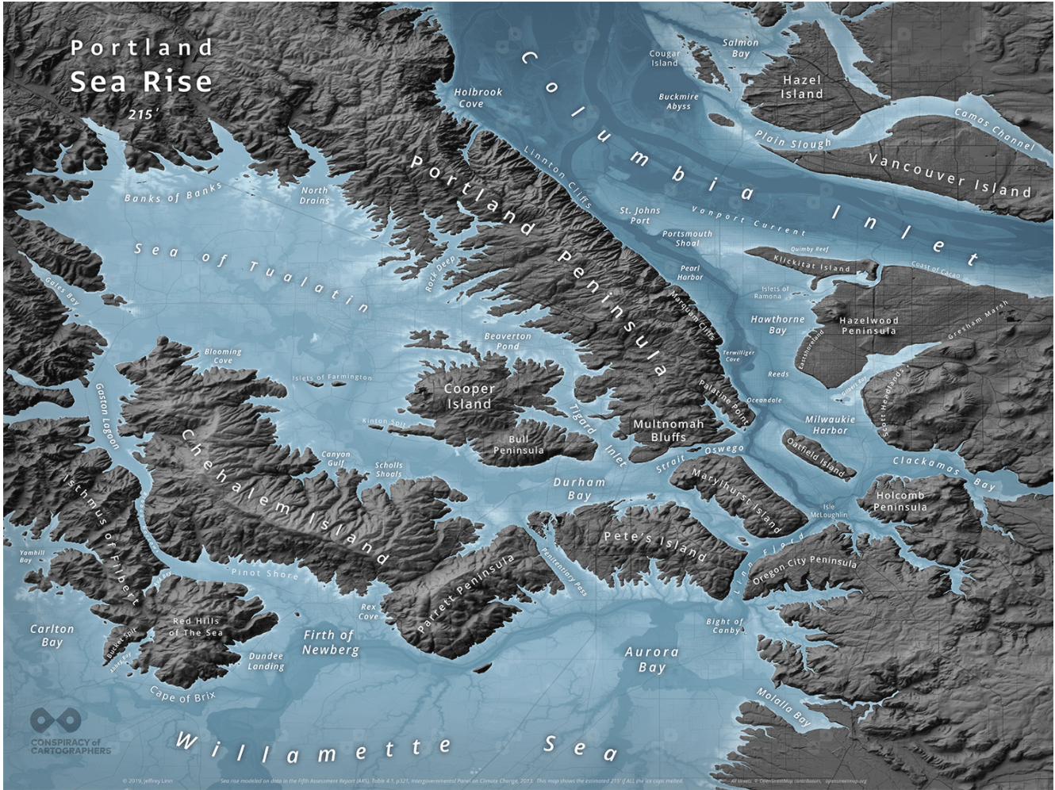
Phenomena: Sea Level Rise in Oregon-
In 2015, a topographic map, which shows elevations in Portland, was published indicating what Portland would look like if climate change and sea levels continue to rise. Find where you live…

Slide 13
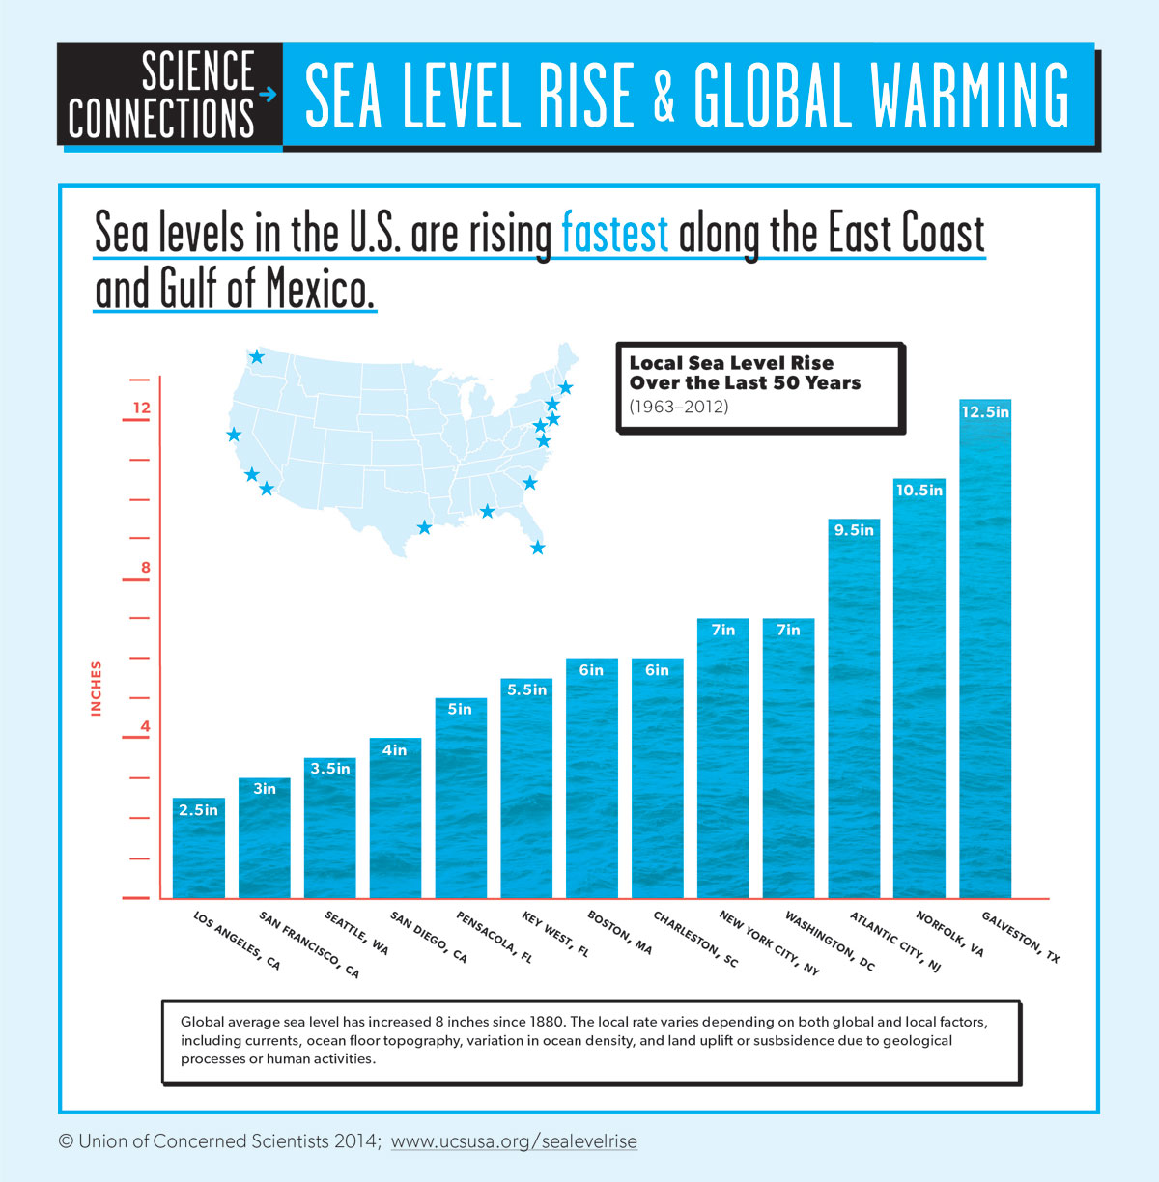
Data Engagement: Sea Level Rise at Similar Latitudes-
In San Francisco the sea rose 3in
In Norfolk the sea rose 10.5 in
Notes:
Give students a minute to consider the question
Have them discuss with a shoulder partner
Report out on the next slide…. or print out table tents with the prompts and so students have them in their hands while they look at this slide

Slide 14
Data Engagement: How we use code to organize raw data into data visualizations-
Bel’s Coding Presentation

Slide 15
Data Engagement: What is causing sea level to rise faster on the East vs. West Coast?
Discuss 3 possible reasons with your group.

Slide 16
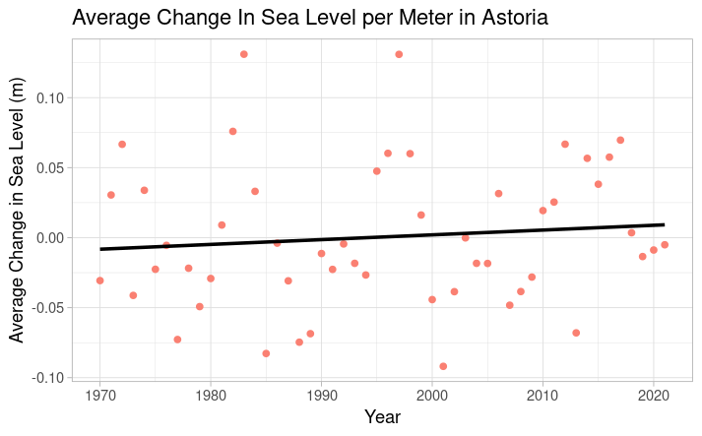
Data Engagement: Astoria Scatter Plot-
What do you notice? What do you wonder? Did you observe a similar trend in the other data visualizations from today/last class?
#Scatter Plot for Astoria
ggplot(Astoria_Avg,aes(x=Year,y=Avg))+
geom_point(color="salmon")+
labs(title="Average Change In Sea Level per Meter in Astoria",y="Average Change in Sea Level (m)")+
theme_light()+geom_smooth(method="lm",color="black",se=FALSE)

Slide 17
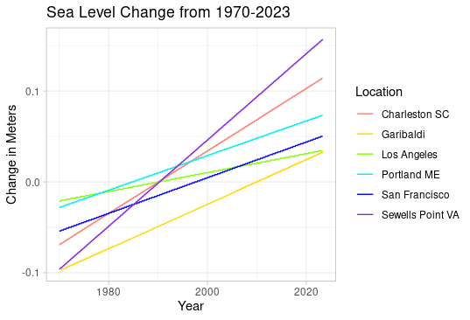
Data Engagement: East vs West Coast Sea Level Scatter Plot-
What do you notice? What do you wonder? Did you observe a similar trend in the other data visualizations from today/last class?
#Line Graph Without Marshall Islands: Code
ggplot(no_marshall, aes(x = Date, y = Linear_Trend, color = Location)) +
geom_line()+
scale_color_manual(values = c(
"Charleston SC" = "salmon",
"Garibaldi" = "gold",
"Los Angeles" = "chartreuse",
"Portland ME" = "cyan2",
"San Francisco" = "blue",
"Sewells Point VA" = "blueviolet")) +
theme_light()+
labs(title="Sea Level Change from 1970-2023",x="Year",y="Change in Meters")

Slide 18
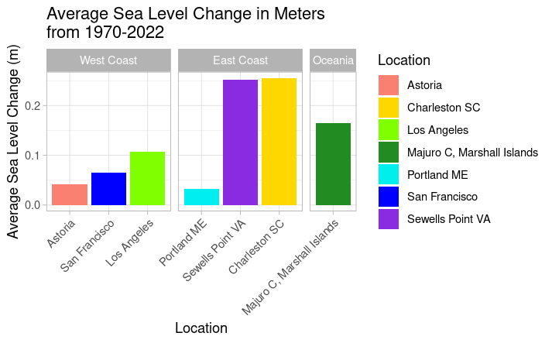
Data Engagement: East vs West Coast Sea Level Bar Plot-
What do you notice? What do you wonder? Did you observe a similar trend in the other data visualizations from today/last class?
ggplot(Ranges_all, aes(x = reorder(Location, Range), y = Range, fill=Location)) +
geom_col(position="dodge")+theme_light()+
labs(x="Location", y="Average Sea Level Change (m)",
title="Average Sea Level Change in Meters \nfrom 1970-2022")+
facet_grid(. ~ Region, drop = TRUE, scales = "free_x", space = "free") +
scale_fill_manual(values=c("Astoria"="salmon", "Charleston SC"="gold",
"Los Angeles"="chartreuse","Portland ME"="cyan2",
"San Francisco"="blue","Sewells Point VA"="blueviolet",
"Majuro C, Marshall Islands" = "forestgreen")) +
theme_light() +
theme(axis.text.x = element_text(angle = 45, hjust = 1))

Slide 19
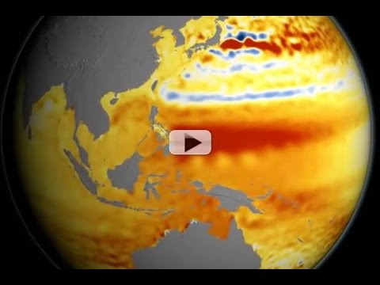
Conclusions: Differences in Sea Level-
Notes:
22 years of satellite sea level rise from NASA/JPL.

Slide 20
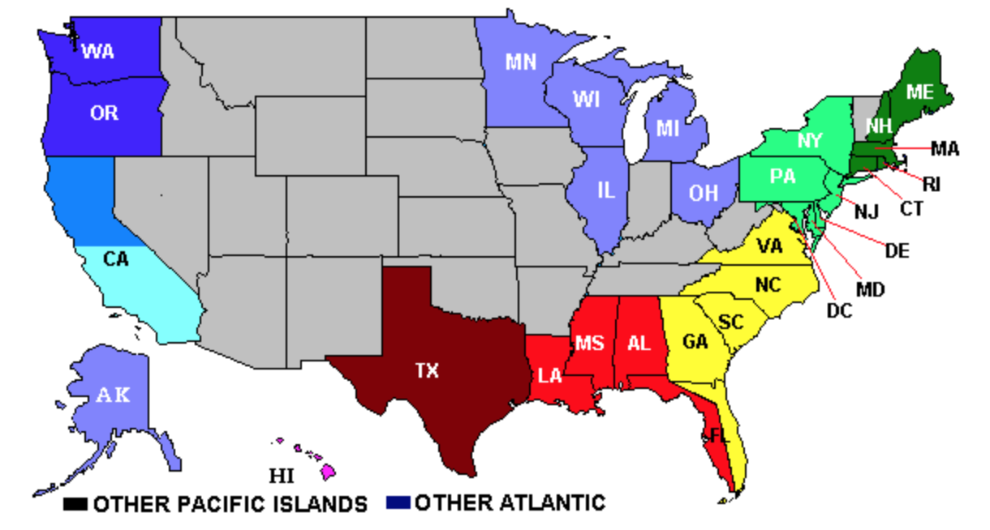
NOAA Coastal Water Temp Guide
Conclusions: East vs West Coast Sea Levels-

Slide 21
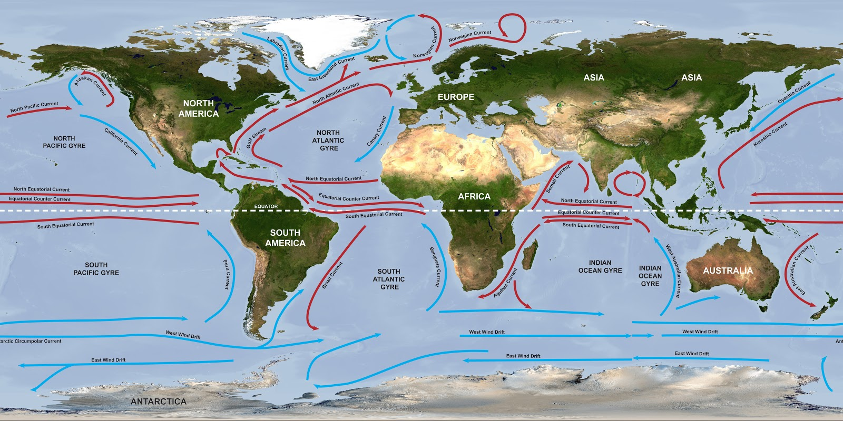
Conclusions: Differences in Sea Level-
This image shows the direction that currents are moving. The red lines indicate warmer water than the blue lines.
Thermohaline circulation, convection currents, and AMOC help to explain differences in sea level rise.

